Slide 1
An Historically Consistent and Broadly Applicable MRV System Based on Lidar Sampling and Landsat Time-series
Warren B. Cohen¹, Hans-Erik Andersen¹, Sean P. Healey¹, Gretchen G. Moisen¹, Todd A. Schroeder¹, Christopher W. Woodall¹, Grant M. Domke¹, Zhiqiang Yang², Stephen V. Stehman³, Robert E. Kennedy², Curtis E. Woodcock⁴, Zhe Zhu⁵, Jim Vogelmann⁵, Dan Steinwand⁵, Chengquan Huang⁶
¹USDA Forest Service, ²Oregon State University, ³State University of New York, ⁴Boston University, ⁵USDI Geological Survey, ⁶University of Maryland
CMS Science Team Meeting, 12-14 November, Bethesda, MD

Slide 2
What’s It About?
Pilot MRV system for possible use by developing counties in reporting an annual forest sector NGHGI
Map & estimate biomass density from 1990-present using consistent methodology
Develop and test methods in the US where
The best datasets available for understanding effects of potential components on uncertainty
And to improve US NGHGI reporting

Slide 3
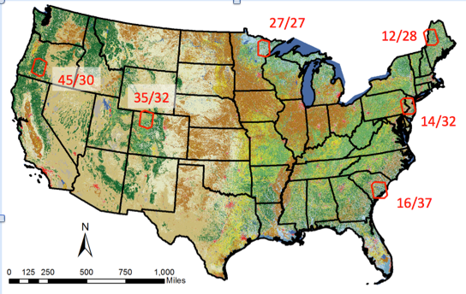
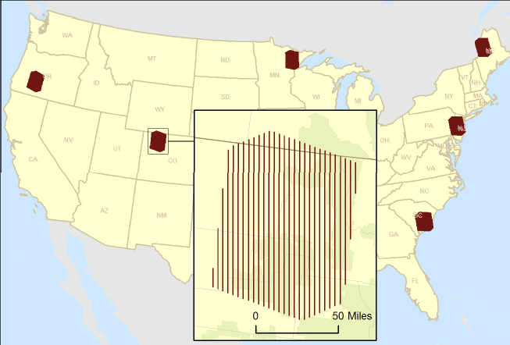
What Are the Main Components?
Field plots for current biomass data
Lidar strip samples to “assist” the plot data
Landsat time series characterize forest change
Two biomass estimation frameworks: design- based & model-based

Slide 4
What is Design-based Estimation?
Where unbiased estimates (of biomass) are derived from a probability-based sample of plots, and estimator used to characterize uncertainty associated with sample size and design; examples include
Large sample of plot measurements (e.g., NFI, such as FIA)
Plots (fewer) & lidar strips and other datasets to reduce uncertainty (model-assisted)
Good solutions for current biomass depending on country-specific data capabilities & costs
Historic datasets likely rare or inconsistent

Slide 5
What is Model-based Estimation?
Where (often biased) estimates (of biomass) are derived from a model, and uncertainty characterized by the model and conditioned on the sample used to develop the model
Probability-based sample not required
Model predictor datasets must be available
Good solution for historic biomass prediction where Landsat data exist that describe forest disturbance history, from which history metrics can be used as predictors
Strategy to minimize bias

Slide 6
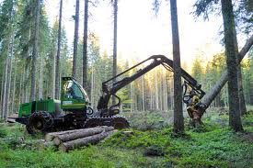
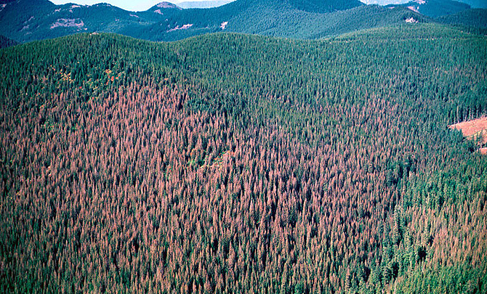
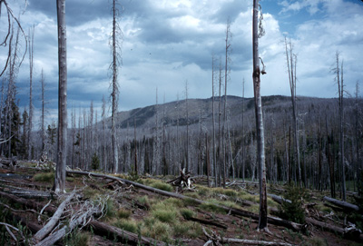
What is Forest Disturbance History?
Incudes both disturbance & succession – continuous processes that alter the composition and structure of a forest
Insects
Fire
Harvest
Succession

Slide 7
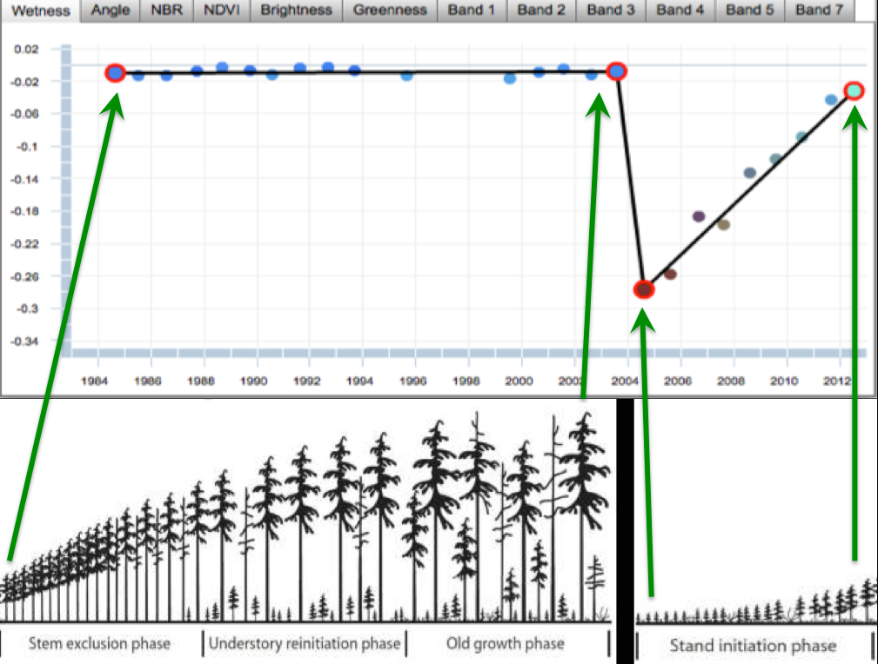
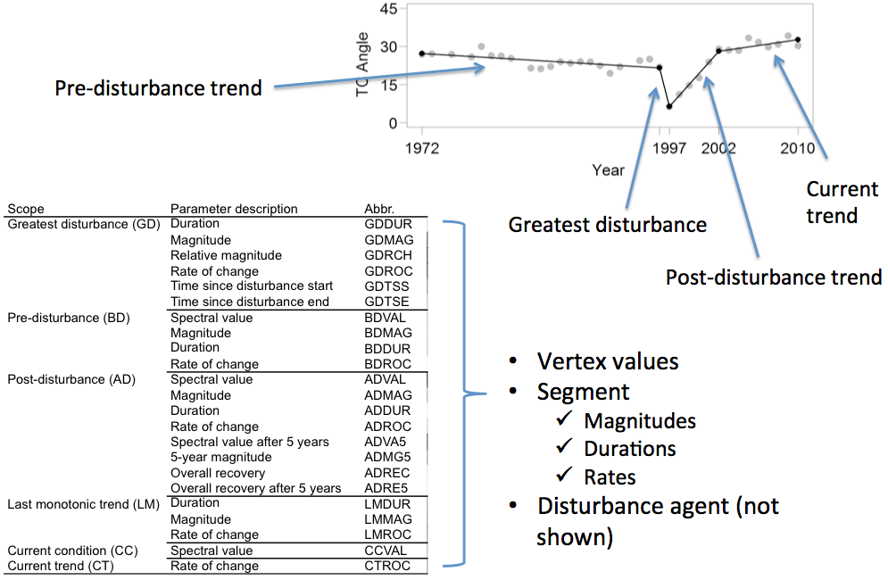
Why Are History Metrics Important?
They describe disturbance & recovery history
Their use can help bust through the reflectance saturation problem significantly strengthening the Landsat signal:
And a single model can be applied through time…

Slide 8
Predicting Current & Past Biomass Density
e.g., 20 years disturbance history to predict current and historic aboveground live biomass
Annual hindcast =
Biomass trajectory
MSS→OLI
MSS→TM
TM→OLI

Slide 9
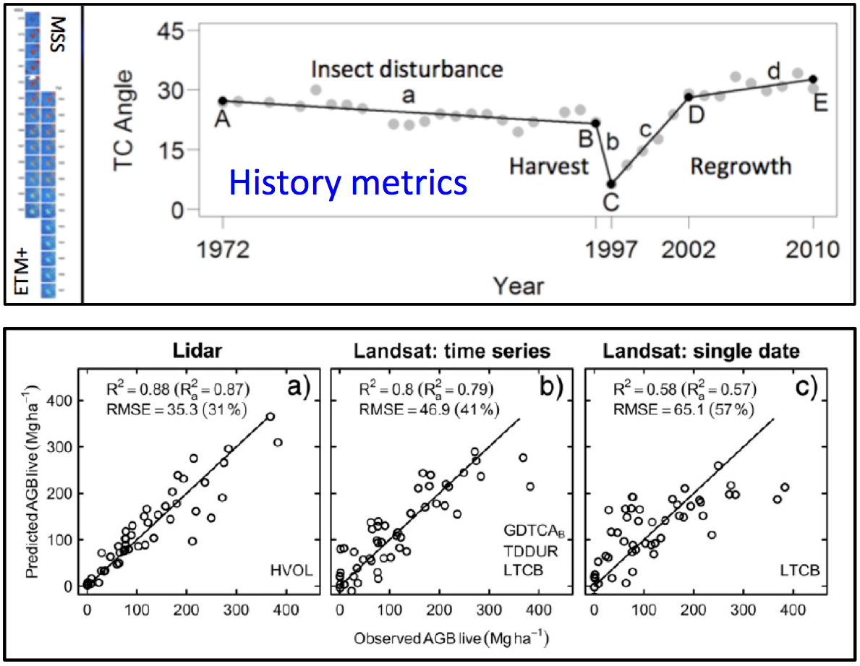
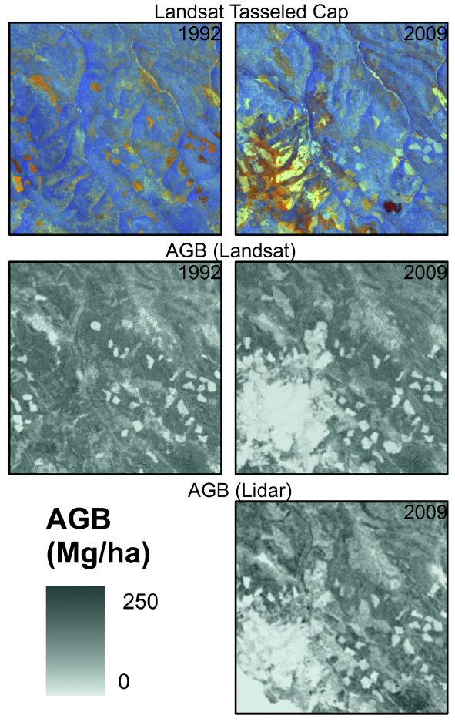
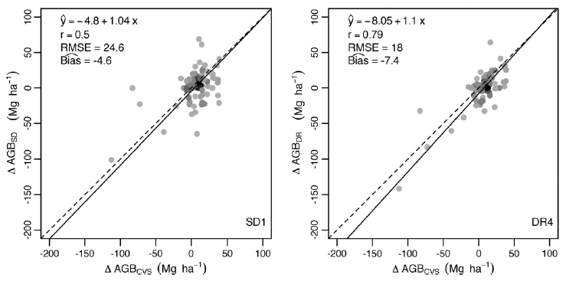
How Well Can History Metrics Work?

Slide 10
How Can the US NGHGI Be Improved?
UN review highlighted two important problems
Re-assess the 1990-present forest carbon trendline derived from periodic and annual FIA data to ensure trendline fluctuations are accurate as opposed to artifacts of inventory design changes
Clearly account for carbon stock and stock change trends for forestland remaining forestland separately from land converted to & from forest
This project should help with both of these, using the model-based approach that employs a consistent, time invariant disturbance-based model that captures change agent

Slide 11
Can Disturbance Mapping Be Improved?
Disturbance maps are always biased, with some imbalance in omission and commission; commonly lacking causal agent information
Omission usually dominates because there is a lot of relatively subtle, but widespread (and thus important) disturbance that most algorithms do not detect
Our solution is ensemble integration of multiple maps
Working with a number of the best algorithm developers in the business towards this end
Trained with casual agent information
Early indications positive

Slide 12
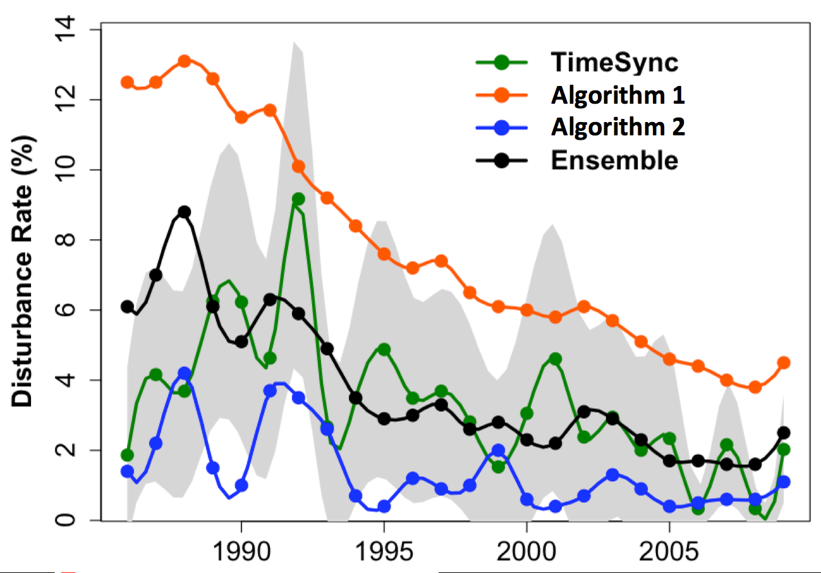
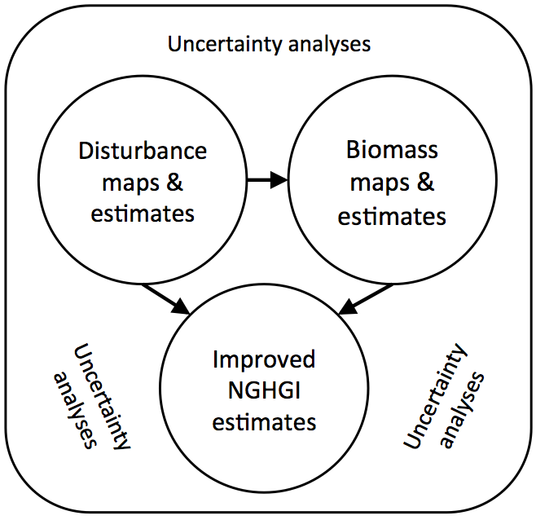
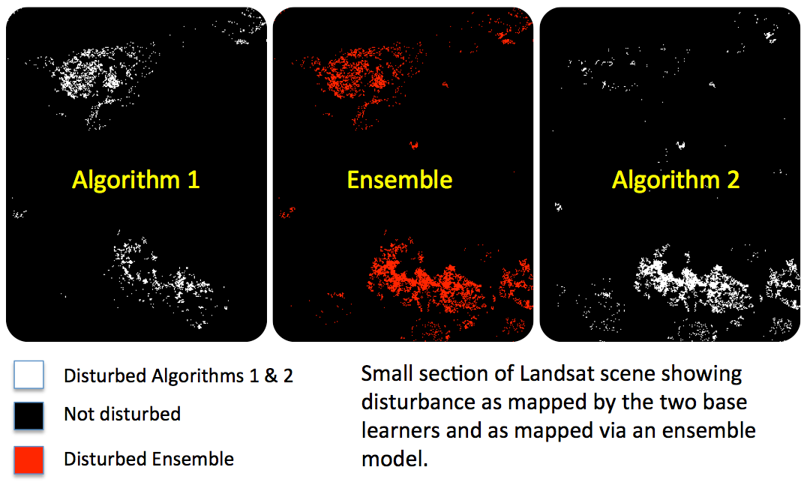
1
TimeSync reference data
Landsat stacks
3
3
1
Individual disturbance maps
Disturbance estimates
3
1
2
1
2
2
1
Ensemble disturbance map
3
1
2
Disturbance metrics
4
5
3
1
2
1
2
2
Field plots
Lidar strips
Biomass maps
1
2
Biomass estimates: 1. Design-based (current), 2. Model-based (current, historic)

